Slide 1
Name Services
Introduction
Name services
Domain Name System
Directory and discovery services
Case study of the Global Name Service
Summary

Slide 2
What is Name Service?
Names: used to refer resources.
Descriptive attributes also useful means of identification.
E.g. file name: /etc/passwd or URL: www.cdk4.net
E.g. Remote object reference or remote file handles.
A distinct service that is used by client to obtain attributes such as the addresses of resources or objects when given their names
Fundamental Trios:
Names
Addresses
Routes (path)
Notes:
Names are not the only useful means of identification: descriptive attributes are
another. Sometimes clients do not know the name of the particular entity that they seek,
but they do have some information that describes it. Or they may re
Applies to
Programs
Files
Machines (aka hosts)
Services (remote and local)
People
Places
Things (objects)
…
Name — index.html
Address — inode #54321
Route (path) —
/csshare/cs4513/public_html/b10/index.html

Slide 3
Name and Address
Name
A human readable string
Address
Bits used by machines to locate an object
Bind
Association between a name and an address
Resolve
Translate from a name to an address
Example

Slide 4
Attributes
Attributes: Value of a property associated with an object.
DNS
IP address
X.500
Person’s email address and telephone number
CORBA Naming Service
Remote object reference

Slide 5
Uniform Resource Identifiers
URL (Uniform Resource Location)
Addresses of web resources
Dangling problems: a resource may be moved
URN (Uniform Resource Name)
Pure resource names
Intend to solve the dangling problems
URN lookup service: mapping from URN to URL
E.g. urn:ISBN:0-201-62433-8 identifies books that bear the name 0-201-62433-8 in
the standard ISBN naming scheme
Notes:
The URN merely identifies a resource. A URL allows you to specify where to locate a resource.
The URI can represent both the URL and the URN of a resource, simultaneously, while URL can only specify the address of the resource on the internet.

Slide 6
General name service requirements
Supports to resolve a name i.e. to lookup attributes from a given name.
Motivation for name management:
Unification: It is often convenient for resources managed by different services to use the same naming scheme. URIs are a good example of this.
Integration: Common name service is required in DS because of sharing. (Different Domains)
Scalability
Arbitrary number of names
Arbitrary number of administrative organizations
Flexibility
A long lifetime
Accommodate variations on the organization of the set of names
Notes:
Namespace – the set of possible names that can be resolved by a particular system or naming service
E.g.,
Set of strings
Set of strings of a particular structure
Set of sounds

Slide 7
General name service requirements (2)
High availability
Most other systems depend upon it
Fault isolation
Isolate location failures from entire service
Tolerance of mistrust
Not all clients are trusted by all components of the system

Slide 8
When you hand a name to a naming system to resolve, it must …… look it up to find the corresponding object or entity
Resolve
When you hand an address to a system, it already knows how to find it.
E.g., an IP address, an i-node of a file system
When you hand a path (i.e., a route) to a system, you are giving it a sequence of steps it knows how to follow
Iteratively or recursively

Slide 9
Name spaces
A collection of all valid names recognized by a particular service
Require a syntactic definition
Hierarchic Name spaces:
Each part of name is resolved relative to a separate context.
E.g. file system- directory represents a context.

Slide 10
Internal structure of a name
Hierarchic structure, e.g. /etc/passwd
Resolve relative to a separate context
Potentially infinite
Different context managed by different people
Alias
Notes:
An alias is a name defined to denote the same information as another name,
similar to a symbolic link between file path names.

Slide 11
Naming domain
A single administrative authority
A name space for which there exists a single authority
E.g. www.pku.edu
Be stored in a separated server
Naming domains are in general stored in different name servers

Slide 12
Combining name spaces
Homogeneous/ heterogeneous name spaces
Merging
E.g. mount file system in Unix and NFS
E.g. create a higher-level root context
How?
Each computer has its own root, with overlapping file names. For example, /etc/passwd refers to one file on red and a different file on blue.

Slide 13
The obvious way to merge the file systems is to replace each computer’s root with a ‘super root’ and mount each computer’s file system in this super root, say as /red and /blue. Users and programs can then refer to/red/etc/passwd and /blue/etc/passwd.

Slide 14
Heterogeneity:
DS allows heterogeneous name spaces to be embedded within it.
DCE names may contain junctions, which are similar to mount points in NFS and UNIX except that they allow heterogeneous name spaces to be mounted.
Ex: /.../dcs.qmul.ac.uk/principals/Jean.Dollimore. Junction
Cell
Notes:
The Distributed Computing Environment (DCE) name space [OSF
1997] allows heterogeneous name spaces to be embedded within it. DCE names may
contain junctions, which are similar to mount points in NFS and UNIX (see Section
12.3), except that they allow heterogeneous name spaces to be mounted. For example,
consider the full DCE name /.../dcs.qmul.ac.uk/principals/Jean.Dollimore. The first part
of this name, /.../dcs.qmul.ac.uk, denotes a context called a cell. The next component is
a junction. For example, the junction principals is a context containing security
principals in which the final component, Jean.Dollimore, may be looked up, and in
which these principal names have their own syntax. Similarly, in
/.../dcs.qmul.ac.uk/files/pub/reports/TR2000-99, the junction files is a context
corresponding to a file system directory, in which the final component
pub/reports/TR2000-99 is looked up and in which the file name space has a distinct
syntax. The two junctions principals and files are the roots of heterogeneous name
spaces, implemented by heterogeneous name services.

Slide 15
Customizing name spaces
One file with different names
E.g. a NFS directory mounted on different machines
One name refer to different files
E.g. install configuration for multi-platform
One name space per people

Slide 16
Name resolution
Resolution is an iterative process, where a name is repeatedly presented the naming context.
Name space is partitioned in different name servers(very large database)
Navigation: process of locating naming domain from more than one name server is order to resolve name.
Iterative navigation
Client controlling
E.g., DNS, NFS
Maps given name
onto attributes.
e.g. /etc/passwd
NS2
2
Name
Client
1
NS1
servers
3
NS3
A client iteratively contacts name servers NS1–NS3 in order
to resolve a name

Slide 17
To resolve a name, it is first presented to some initial naming context; resolution iterates as long as further contexts and derived names are output.
Example: /etc/passwd, in which ‘etc’ is presented to the context ‘/’, and then ‘passwd’ is presented to the context ‘/etc’.

Slide 18
One navigation model that DNS supports is known as iterative To resolve a name, a client presents the name to the local name server,
which attempts to resolve it.
The local name server has the name, it returns the result immediately. If it does not, it will suggest another server that will be able to help.
Resolution proceeds at the new server, with further navigation as necessary until the name is located or is discovered to be unbound.

Slide 19
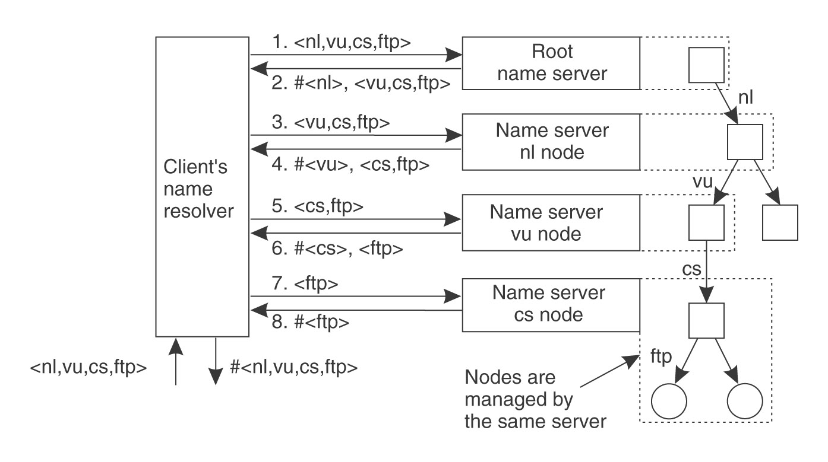
E.g., ftp.cs.vu.nl

Slide 20
Server controlled navigation
Non-recursive/Recursive
Recursive type is suitable to environment where there are administrative domain prohibits
NS2
NS2
2
2
4
3
1
1
client
NS1
client
NS1
4
3
5
NS3
NS3
Non-recursive
Recursive
server-controlled
server-controlled
A name server NS1 communicates with other name servers on behalf of a client

Slide 21
Under non-recursive server-controlled navigation, any name server may be chosen by the client.
This server communicates by multicast or iteratively with its peers in as it were a client.
Under recursive server-controlled navigation, the client once more contacts a single server.
If this server does not store the name, the server contacts a peer storing a (larger) prefix of the name, which in turn attempts to resolve it.
This procedure continues recursively until the name is resolved.

Slide 22
If a name service spans distinct administrative domains, then clients executing in one administrative domain may be prohibited from accessing name servers belonging to another such domain.
Moreover, even name servers may be prohibited from discovering the disposition of naming data across name servers in another administrative domain.
Then, both client-controlled and non-recursive server-controlled navigation are inappropriate, and recursive server-controlled navigation must be used.

Slide 23
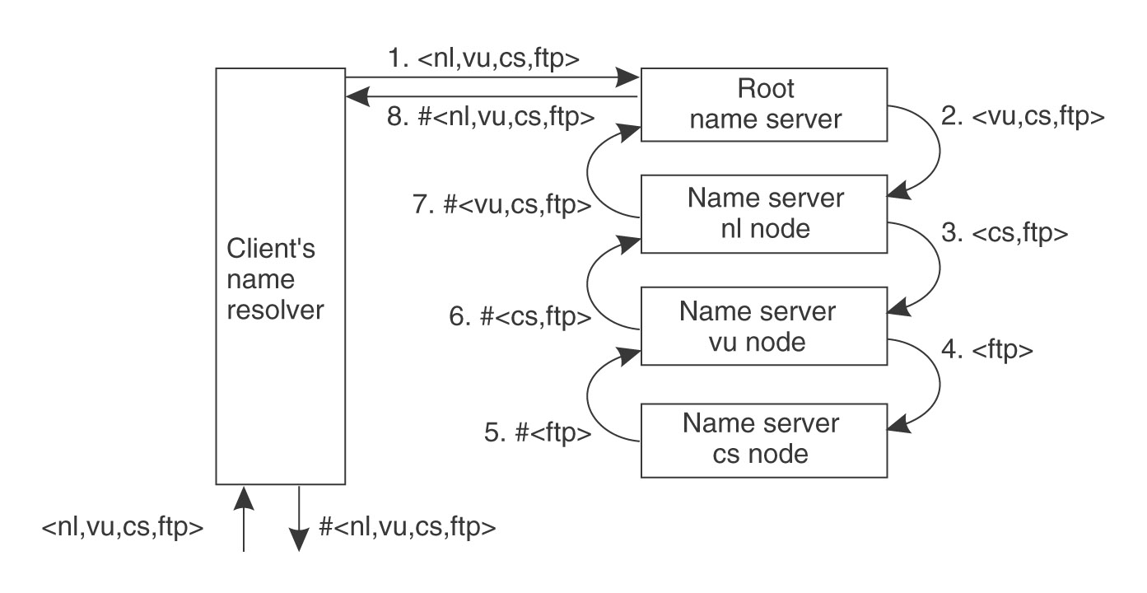
E.g., ftp.cs.vu.nl

Slide 24
Caching tech. in name resolution
To store the result of previous name resolutions.
Enhance response time
Eliminate the workload of high-level name servers
Isolate the failures of high-level name servers

Slide 25
The Domain Name System
Original Internet Naming scheme
A central master files
Download to all hosts by FTP
Domain names [1987]
Name space is partitioned both organizationally and according to geography
Convert domain names into IP addresses
Hierarchical partitioning of the name database, replication of naming data & Caching.

Slide 26
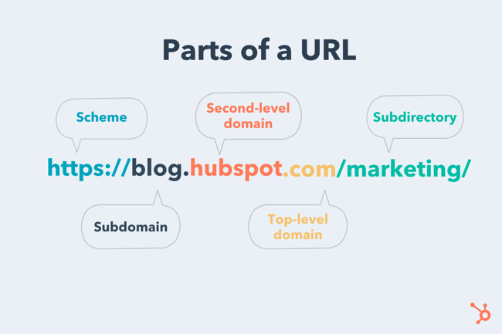

Slide 27
The DNS name space: Top Level Domains
Com – Commercial organizations
Edu – Universities and other educational institutions
Gov – US governmental agencies
Mil – US military organizations
Net – Major network support centres
Org – Organizations not mentioned above
Int – International organizations
Us – united States
Uk – United Kingdom
Cn - China

Slide 28
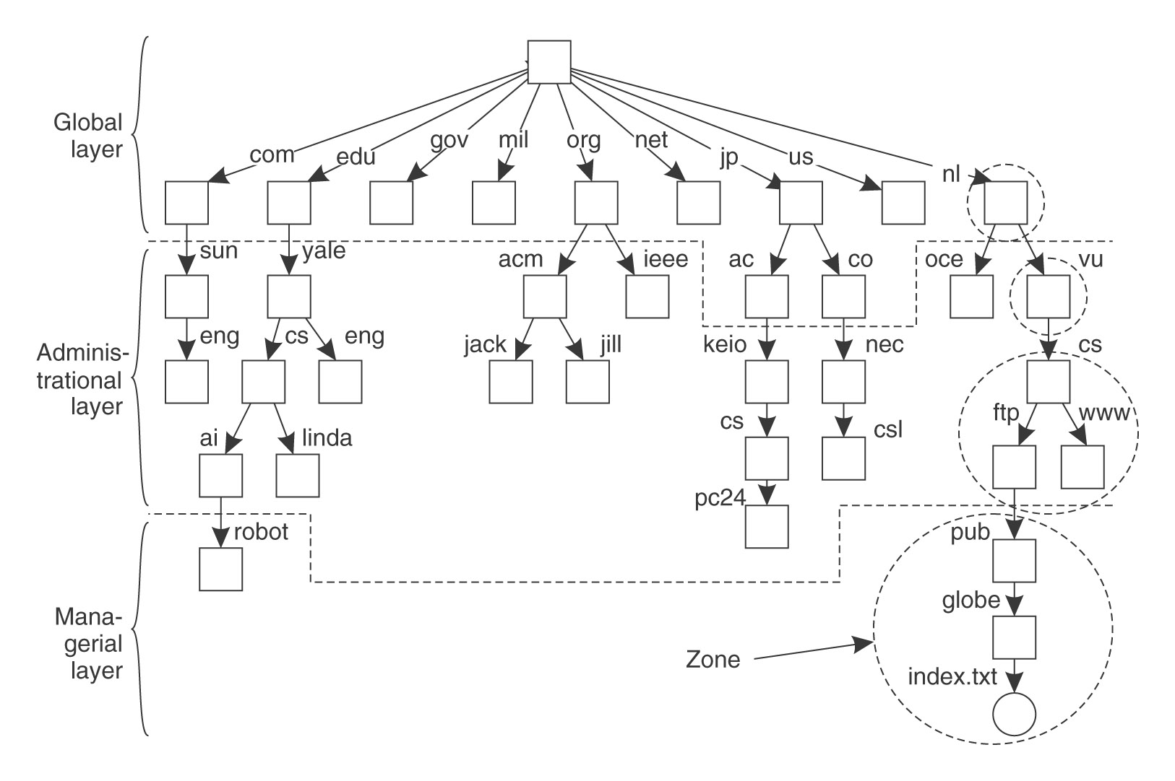

Slide 29
DNS queries
Internet DNS is primarily used for simple host name resolution and for looking up electronic mail hosts, as follows:
1. Host name resolution: From URL to IP address
2. Mail host location
Given a domain name, return a list of domain names of hosts that can accept the mail
E.g. tom@dcs.rnx.ac.uk DNS is queried with the address dcs.rnx.ac.uk and the type designation ‘mail’. It returns a list of domain names of hosts that can accept mail for dcs.rnx.ac.uk, if such exist.
3. Reverse resolution: From IP to URL

Slide 30
DNS queries …continued
4. Host information
E.g. the architecture type or operating system of a machine
5. Well-known services
A list of the services run by a computer (telnet/ ftp)
Protocol used to obtain them (UDP & TCP)

Slide 31
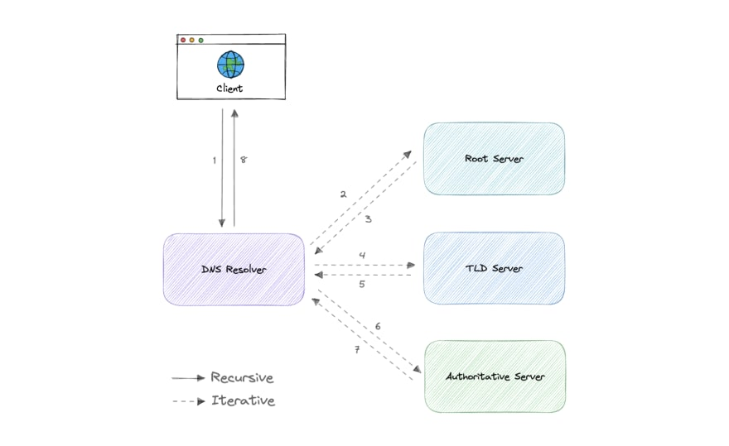

Slide 32
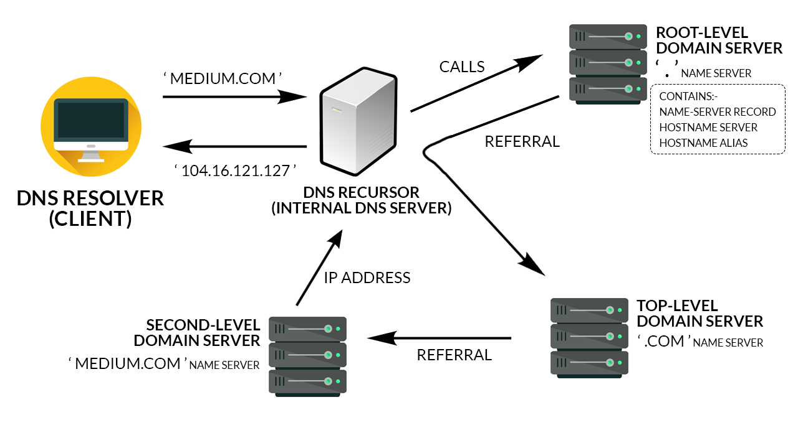

Slide 33
DNS name servers
DNS names are divided into Zones
Zone
Include names in the domain, less any sub-domains(a zone could contain data for Queen Mary, University of London – qmul.ac.uk – less the data held by departments (for example the Department of Computer Science – dcs.qmul.ac.uk).
At least two name servers for the zone
Hold name servers for the sub-domains
Each server hold zero or more Zones
Zero zone: the caching name server

Slide 34
DNS name servers …continued
Servers that a name server holds
Lower-level name servers
Child name servers
High-level name servers
One or more root name servers
Parent name server

Slide 35
DNS name resolution
Iterative navigation / recursive navigation
Example
DNS resource types

Slide 36
Navigation and Query Processing
Resolver: Client that access name server.
Resolver specifies which type of navigation is required.
Recursive and Iterative Navigation
BIND: Berkeley Internet Name Domain
Implementation of DNS on UNIX
Supports primary, secondary and cache-based servers
Notes:
BIND (Berkeley Internet Name Domain) is an implementation of the DNS protocols and provides an openly redistributable reference implementation of the major components of the Domain Name System, including Domain Name System server, Domain Name System resolver library and tools for managing and verifying the proper ...

Slide 37
DNS performance
Replication
Zone data are replicated on at least two name servers
Master server / secondary server
Synchronize periodically
Cache
Any server is free to cache data
Time-to-live value

Slide 38
DNS performance (2)
Availability & Scalability
Achieved by a combination of replication, cache and partition
Acceptable inconsistent naming data

Slide 39
Directory Services
A special kind of naming service
Searching attributes (no name but knows only attributes)
E.g. What is the name of user who is phone number is 0250-22224533
Which computer in this building is running on MAC OS?
Directory Service: a service that stores collections of bindings between names and attribute and looks up entries that match attribute-based specifications.
Entries
Each entry is concerned with a set of <attribute, value> pairs
Query
Lookup by known attributes
Return interested attributes
E.g. query one’s telephone No. by his name

Slide 40
Directory services (2)
Yellow page / white page
Directory service / Conventional naming service
Directory servers and navigation
Similar to name service
Example
Active Directory Service
X.500
LDAP

Slide 41
Discovery services
A special kind of directory service
Register the services provided in a spontaneous network.(can connect and disconnect unpredictably.)
General operations
Register / lookup / de-register
E.g. a registered printer
ResourceClass=printer, type=laser, colour=yes, resolution=600dpi,
Location=room101, url=http://www.hotelDuLac.com/services/printer57

Slide 42
Introduction to GNS(Global Name Service)
Designed by DEC lab [lampson 1986]
To provide facilities for resource location, mail addressing and Authentication
Design objectives of GNS:
Large Size: Millions of computer names
Long life time: accommodate changes
High Availability
Fault Isolation: Local failures don’t cause the entire system to fail.
Tolerance of Mistrust

Slide 43
Architecture of GNS
Directory tree / value tree
Two levels:
Client Level: hierarchical names & their values with operations
Admin Level: Synchronized copies of database
Directory identifier (DI)
Unique identifier of a directory
Client side: Name of an entry
<directory name, value name>
E.g. <EC/UK/AC/QMW, Peter.Smith/password>

Slide 44
Architecture of GNS (2)
Multiple name servers
Directory tree is partitioned and stored in many servers
Replication
Each partition is replicated in several servers
Cache
Inconsistency cache data is acceptable

Slide 45
How does GNS accommodate changes?
Merge two name space by a super-root
How to it transparent to client applications?
E.g. how to locate /uk/ac/qmw ?
DI: 633
(WORLD)
Well-known directories:
#599 = #633/EC
#642 = #633/NORTH AMERICA
EC
NORTH AMERICA
DI: 599
DI: 642
US
CANADA
DI: 543
UK
FR
DI: 574
DI: 732
DI: 457

Slide 46
Working root DI
Client agent
Store the DI of working root by client agent
E.g., for </UK/AC/QMW, Peter.Smith>, client agent stores #599 which is the DI of “/”, i.e. EC
Resolve name
Working root DI + relative path
Uniquely refer to a name in the merged tree
E.g. <#599/UK/AC/QMW, Peter.Smith>

Slide 47
Well-known directories
A table of well-know directories
Mapping between working root DI to new absolute path
Replication
Well-know directories are replicated at each nodes
Bottleneck of consistency
Examples

Slide 48
Composed naming domains used to access a resource from a URL
URL
http://www.cdk3.net:8888/WebExamples/earth.html
DNS lookup
Resource ID (IP number, port number, pathname)
55.55.55.55
8888
WebExamples/earth.html
Web server
Network address
2:60:8c:2:b0:5a
file
Socket
Notes:
Figure 13.1 shows the domain name portion of a URL resolved first via the DNS into an IP address and then, at the final hop of Internet routing, via ARP to an Ethernet address for the web server. The last part of the URL is resolved by the file system on the web server to locate the relevant file.

Slide 49
DNS name servers
a.root-servers.net
(root)
uk
ns1.nic.uk
purdue.edu
(uk)
yahoo.com
ns.purdue.edu
(purdue.edu)
co.uk
ac.uk
ns0.ja.net
(ac.uk)
* .purdue.edu
ic.ac.uk
qmw.ac.uk
dcs.qmw.ac.uk
*.dcs.qmw.ac.uk
*.ic.ac.uk
*.qmw.ac.uk
alpha.qmw.ac.uk
dns0.dcs.qmw.ac.uk
dns0-doc.ic.ac.uk
(qmw.ac.uk)
(dcs.qmw.ac.uk)
(ic.ac.uk)
Name server names are in italics, and the corresponding domains are in
parentheses. Arrows denote name server entries
Notes:
the domain name jeans-pc.dcs.qmul.ac.uk can be looked up from within dcs.qmul.ac.uk using the local server dns0.dcs.qmul.ac.uk.

Slide 50
DNS resource records
Record type
Meaning
Main contents
A
A computer address
IP number
NS
An authoritative name server
Domain name for server
CNAME
The canonical name for an alias
Domain name for alias
SOA
Marks the start of data for a zone
Parameters governing the zone
WKS
A well-known service description
List of service names and protocols
PTR
Domain name pointer (reverse
Domain name
lookups)
HINFO
Host information
Machine architecture and operating
system
MX
Mail exchange
List of <
preference, host
> pairs
TXT
Text string
Arbitrary text
Zone data are stored by name servers in files in one of several fixed
types of resource record.

Slide 51
GNS directory tree and value tree for user Peter.Smith
DI: 599
(EC)
DI: 543
UK
FR
DI: 574
DI: 437
AC
DI: 322
QMW
Peter.Smith
mailboxes
password
Alpha
Beta
Gamma

Slide 52
Merging trees under a new root
DI: 633
(WORLD)
Well-known directories:
#599 = #633/EC
#642 = #633/NORTH AMERICA
EC
NORTH AMERICA
DI: 599
DI: 642
US
CANADA
DI: 543
UK
FR
DI: 574
DI: 732
DI: 457

Slide 53
Restructuring the directory
DI: 633
(WORLD)
Well-known directories:
#599 = #633/EC
#642 = #633/NORTH AMERICA
EC
NORTH AMERICA
DI: 599
DI: 642
US
US
CANADA
DI: 543
UK
FR
DI: 574
DI: 732
DI: 457
#633/EC/US

